Slide 1
Machine Learning
A/Prof. Xiaofeng Zhu
s.zhu@massey.ac.nz
TA: Mr. Jingting Zhu and Mr. Rongyao Hu

Slide 2
Outline
What is machine learning
How to use machine learning

Slide 3
What is Machine Learning?

Slide 4
What is machine learning
A branch of artificial intelligence.
Machine learning is the scientific study of algorithms and statistical models that computers use to effectively perform a specific task without using explicit instructions.

Slide 5
Related Disciplines
decision
theory
game
theory
AI
control
theory
information
theory
biological
evolution
Machine
Learning
probability
&
statistics
philosophy
optimization
Data Mining
statistical
mechanics
psychology
computational
complexity
theory
neurophysiology

Slide 6
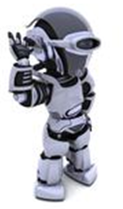
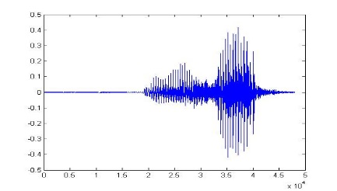
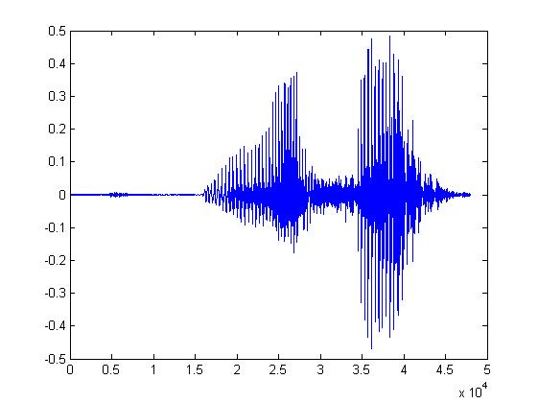
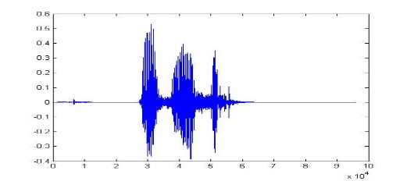
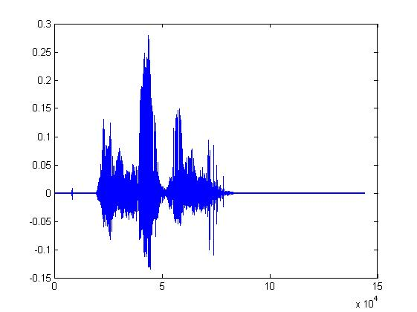
What is Machine Learning?
Learning ......
“Hi”
“How are you”
You said “Hello”
“Good bye”
You write the program for learning.
A large amount of audio data

Slide 7
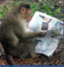

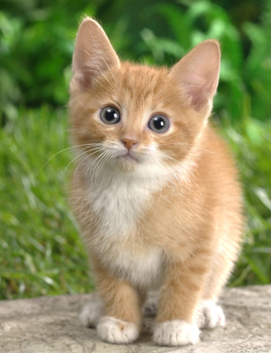

What is Machine Learning?
Learning ......
“monkey”
“cat”
This is “cat”
“dog”
You write the program for learning.
A large amount of images

Slide 8

Machine Learning ≈ Looking for a Function
Speech Recognition
Image Recognition
“How are you”
“Cat”
y = f(x)
Training: given a training set of labeled examples {(x₁,y₁), …, (x_{N},y_{N})}, estimate the prediction function f by minimizing the prediction error on the training set
Testing: apply f to a unseen test example x and output the predicted value y = f(x)
output
Image feature
prediction function

Slide 9

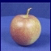
Machine learning steps
Training
Training Images
Image Features
Training
Learned model
Testing
Image Features
Learned model
Prediction
Slide credit: D. Hoiem and L. Lazebnik

Slide 10
Train framework
Image Recognition:
“cat”
A set of function
Model
Training
Testing
“cat”
Step 1
Goodness of function f
Pick the “Best” Function
Using
Step 2
Step 3
Training
Data
“monkey”
“cat”
“dog”
Notes:
Repeat again

Slide 11
Training is so simple ……
Step 1: define a set of function
Step 2: goodness of function
Step 3: pick the best function

Slide 12
How to apply machine learning?

Slide 13
Machine learning in a nutshell
A huge number of machine learning algorithms
Millions new every year
Every machine learning algorithm has four steps:
Representation
Model
Evaluation
Visualization

Slide 14
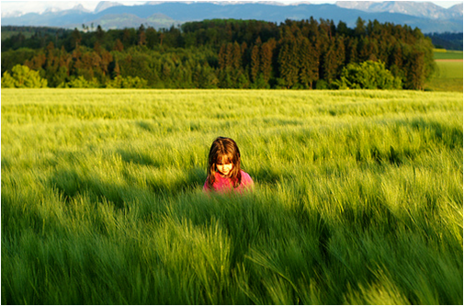
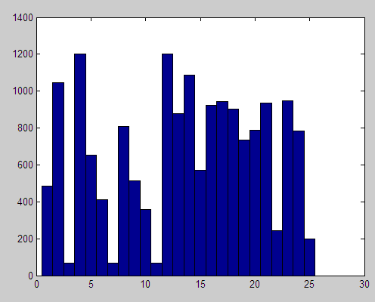
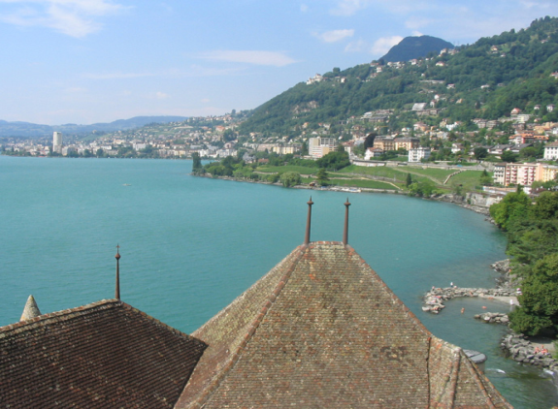
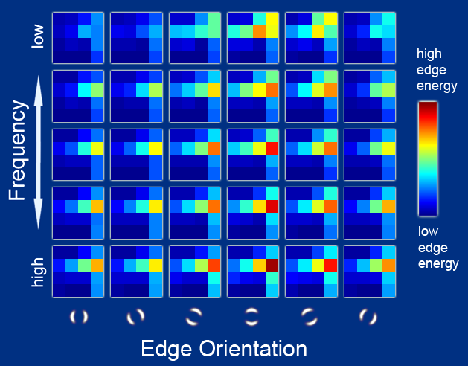
Representation
Raw pixels
Histograms
GIST descriptors
Deep feature
…

Slide 15
Representation
categorical
categorical
continuous
class
Each sample is represented by one vector or matrix

Slide 16
Types of Models
Supervised (inductive) learning
Training data includes desired outputs
Unsupervised learning
Training data does not include desired outputs
Semi-supervised learning
Training data includes a few desired outputs
Transfer learning
Training data includes a few outputs unrelated to training data

Slide 17
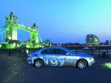
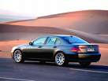
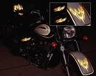
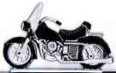
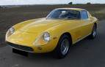
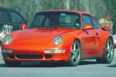

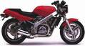

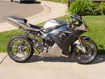
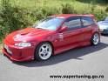
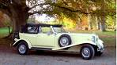
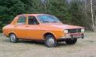
Supervised learning
Testing:
What is this?
Cars
Motorcycles
Notes:
Sometimes, most data wins. So, how to get more data? Even with AMT, often slow and expensive.

Slide 18
Unsupervised learning
Testing:
Which category is this?
Unlabeled images (all cars/motorcycles)
Notes:
Sometimes, most data wins. So, how to get more data? Even with AMT, often slow and expensive.

Slide 19




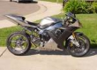

Semi-supervised learning
Unlabeled images (all cars/motorcycles)
Testing:
What is this?

Slide 20
Semi-supervised learning
Unlabeled images (all cars/motorcycles)
Testing:
What is this?
Car
Motorcycle

Slide 21
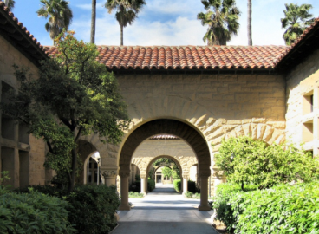

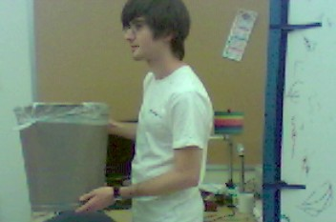
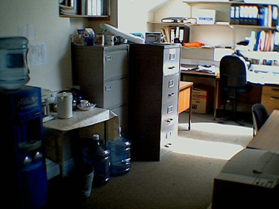
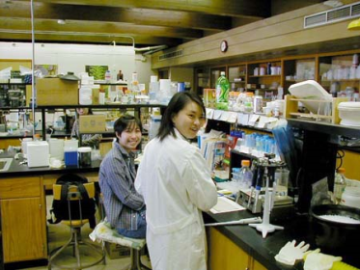
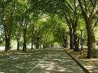
Transfer learning
Car
Motorcycle
Testing:
What is this?
Unlabeled images (random internet images)

Slide 22
Evaluation metric
Accuracy
Precision and recall
Squared error
Likelihood
Posterior probability
Cost / Utility
Margin
Entropy
K-L divergence
… …

Slide 23
How to Estimate the Metrics?
Hold-out method;
k-fold cross-validation method;
Leave-one-out method;
…

Slide 24
Classification: Train, Validation, Test Split
Results Known
+
Model
Builder
+
Training set
-
-
Data
+
Evaluate
Classifier Builder
Predictions
+
-
+
-
Y
N
Validation set
The test data can’t be used for parameter tuning!
+
-
+
-
Final Evaluation
Final Test Set
Classifier

Slide 25
K-fold Cross Validation Example
Split the data into 5 samples
Fit a model to the training samples and use the test sample to calculate a CV metric.
Repeat the process for the next sample, until all samples have been used to either train or test the model

Slide 26
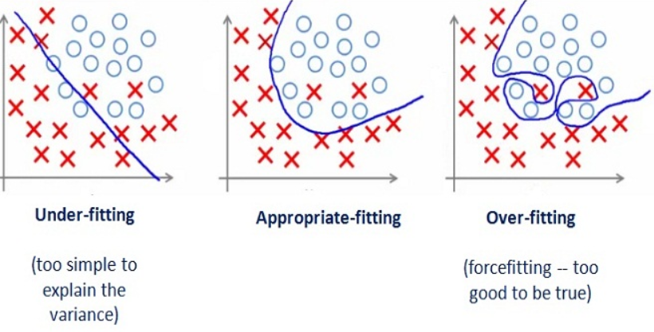
What are we seeking?

Slide 27
Some Issues in Machine Learning
What representation is the best:
What algorithms can approximate functions well, and when?
What evaluation metric is perfect?
How does number of training examples influence accuracy?
How does complexity of hypothesis representation impact it?
How does noisy data influence accuracy?

Slide 28
Resources: Datasets
UCI Repository: http://www.ics.uci.edu/~mlearn/MLRepository.html
UCI KDD Archive: http://kdd.ics.uci.edu/summary.data.application.html
Statlib: http://lib.stat.cmu.edu/
Delve: http://www.cs.utoronto.ca/~delve/

Slide 29
Resources: Journals
Journal of Machine Learning Research
Machine Learning
IEEE Transactions on Neural Networks
IEEE Transactions on Pattern Analysis and Machine Intelligence
...

Slide 30
Resources: Conferences
International Conference on Machine Learning (ICML)
Neural Information Processing Systems (NeurIPS, formerly NIPS)
International Joint Conference on Artificial Intelligence (IJCAI)
Association for the Advancement of Artificial Intelligence (AAAI)
International Conference on Computer Vision (ICCV)
Conference on Computer Vision and Pattern Recognition (CVPR)
International Conference on Learning Representations (ICLR)
ACM SIGKDD Conference on Knowledge Discovery and Data Mining (KDD)
…

